Slide 1

Chapter 4:
Cluster Analysis in Data Mining
Notes:
‹#›

Slide 2
Hierarchical Clustering Me thods
Objective
Understand the concept of hierarchical clustering.
Explore agglomerative and divisive clustering algorithms.
Discover extensions to hierarchical clustering.
Learn about BIRCH, a micro-clustering-based approach.
Recognize the benefits and applications of hierarchical clustering.
Let's embark on a journey through the fascinating world of hierarchical clustering and its implications for data analysis.
‹#›

Slide 3
Hierarchical Clustering Me thods
Hierarchical Clustering Methods
Hierarchical clustering is a technique that organizes data points into a tree-like structure of nested clusters. It offers insights into both macro and micro-level relationships within data.
Hierarchical clustering
  Generate a clustering hierarchy (drawn as a dendrogram)
  Not required to specify K, the number of clusters
  More deterministic
  No iterative refinement
‹#›

Slide 4
Hierarchical Clustering Me thods
Hierarchical Clustering Methods
Two categories of algorithms:
  Agglomerative: Start with singleton clusters, continuously merge two clusters at a time to build a bottom-up hierarchy of clusters
  Divisive: Start with a huge macro-cluster, split it continuously into two groups, generating a top-down hierarchy of clusters
Key Concepts:
  Agglomerative and divisive algorithms build hierarchies from bottom-up and top-down, respectively.
  Hierarchical clustering produces dendrogram visualizations.
  Provides flexibility in exploring clusters at different granularity levels.
  Suitable for various data types and proximity measures.
‹#›

Slide 5
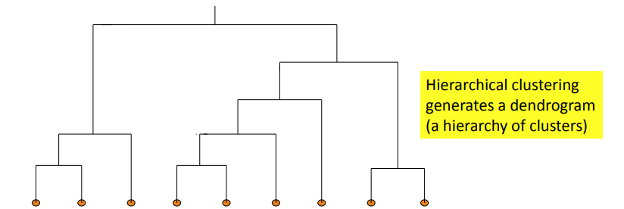
Hierarchical Clustering Me thods
Dendrogram: Shows How Clusters are Merged
Dendrogram: Decompose a set of data objects into a tree of clusters by multi-level nested partitioning
A clustering of the data objects is obtained by cutting the dendrogram at the desired level, then each connected component forms a cluster
‹#›

Slide 6
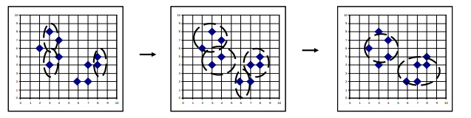
Hierarchical Clustering Me thods
Agglomerative Clustering Algorithms
Agglomerative hierarchical clustering starts with individual data points as separate clusters and progressively merges them.
AGNES (AGglomerative NESting) (Kaufmann and Rousseeuw, 1990)
  Use the single-link method and the dissimilarity matrix
  Continuously merge nodes that have the least dissimilarity
  Eventually all nodes belong to the same cluster
‹#›

Slide 7
Hierarchical Clustering Me thods
Agglomerative Clustering Algorithms
Agglomerative clustering varies on different similarity measures among clusters
  Single link (nearest neighbor)
  Complete link (diameter)
  Average link (group average)
  Centroid link (centroid similarity)r.
‹#›

Slide 8

Hierarchical Clustering Me thods
Single Link vs. Complete Link in Hierarchical Clustering
Single link (nearest neighbor)
  The similarity between two clusters is the similarity between their most similar (nearest neighbor) members
  Local similarity-based: Emphasizing more on close regions, ignoring the overall structure of the cluster
  Capable of clustering non-elliptical shaped group of objects
  Sensitive to noise and outliers
‹#›

Slide 9
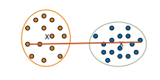
Hierarchical Clustering Me thods
Single Link vs. Complete Link in Hierarchical Clustering
Complete link (diameter)
  The similarity between two clusters is the similarity between their most dissimilar members
  Merge two clusters to form one with the smallest diameter
  Nonlocal in behavior, obtaining compact shaped clusters
  Sensitive to outliers
‹#›

Slide 10
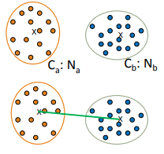
Hierarchical Clustering Me thods
Agglomerative Clustering: Average vs. Centroid Links
Agglomerative clustering with average link
  Average link: The average distance between an element in one cluster and an element in the other (i.e., all pairs in two clusters)
    Expensive to compute
Agglomerative clustering with centroid link
  Centroid link: The distance between the centroids of two clusters
‹#›

Slide 11


Hierarchical Clustering Me thods
Agglomerative Clustering: Average vs. Centroid Links
Group Averaged Agglomerative Clustering (GAAC)
  Let two clusters Ca and Cb be merged into CaUb.
The new centroid is:
    Na is the cardinality of cluster Ca, and ca is the centroid of Ca
  The similarity measure for GAAC is the average of their distances
Agglomerative clustering with Ward’s criterion
  Ward’s criterion: The increase in the value of the SSE criterion for the clustering obtained by merging them into Ca U Cb:
‹#›

Slide 12
Hierarchical Clustering Me thods
Agglomerative Clustering Algorithms
Dendrogram Visualization:
  Depicts the merging process as a tree diagram.
  Height of the fusion indicates the dissimilarity between clusters.
  Cutting the dendrogram yields clusters at desired granularity.
  Agglomerative clustering is intuitive and versatile, but it can be computationally expensive for large datasets.
‹#›

Slide 13
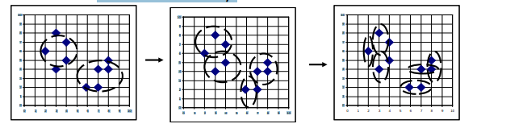
Hierarchical Clustering Me thods
Divisive Clustering Algorithms
Divisive hierarchical clustering begins with all data points in a single cluster and recursively divides them.
DIANA (Divisive Analysis) (Kaufmann and Rousseeuw,1990)
  Implemented in some statistical analysis packages, e.g., Splus
Inverse order of AGNES: Eventually each node forms a cluster on its own
‹#›

Slide 14
Hierarchical Clustering Me thods
Divisive Clustering Algorithms
Divisive clustering is a top-down approach
  The process starts at the root with all the points as one cluster
  It recursively splits the higher level clusters to build the dendrogram
  Can be considered as a global approach
  More efficient when compared with agglomerative clustering
‹#›

Slide 15
Hierarchical Clustering Me thods
Divisive Clustering Algorithms
Dendrogram Visualization:
  Starts with a single cluster that splits into subclusters.
  Divisions occur at varying levels of granularity.
  Also yields a dendrogram, highlighting the hierarchical structure.
  Divisive clustering allows exploration of finer details within clusters but can be challenging to implement effectively.
‹#›

Slide 16
Hierarchical Clustering Me thods
Extensions to Hierarchical Clustering
Hierarchical clustering can be extended to handle specific challenges and data characteristics.
Single Linkage (Minimum Linkage):
  Measures distance between two clusters as the minimum distance between any pair of points.
  Vulnerable to "chaining" effect, where distant points influence the linkage.
‹#›

Slide 17
Hierarchical Clustering Me thods
Extensions to Hierarchical Clustering
Complete Linkage (Maximum Linkage):
  Measures distance between two clusters as the maximum distance between any pair of points.
  Can lead to "crowding" problem, where compact clusters are merged.
Average Linkage:
  Measures distance between two clusters as the average distance between all pairs of points.
  Balanced approach between single and complete linkage.
‹#›

Slide 18
Hierarchical Clustering Me thods
Extensions to Hierarchical Clustering
Major weaknesses of hierarchical clustering methods
  Can never undo what was done previously
  Do not scale well
    Time complexity of at least O(n2), where n is the number of total objects
Other hierarchical clustering algorithms
  BIRCH (1996): Use CF-tree and incrementally adjust the quality of sub-clusters
  CURE (1998): Represent a cluster using a set of well-scattered representative points
  CHAMELEON (1999): Use graph partitioning methods on the K-nearest neighbor graph of the data
‹#›

Slide 19
Hierarchical Clustering Me thods
BIRCH: Balanced Iterative Reducing and Clustering Using Hierarchies
BIRCH is a hierarchical clustering approach designed for large datasets by employing a micro-clustering strategy.
A multiphase clustering algorithm (Zhang, Ramakrishnan & Livny, SIGMOD’96)
Incrementally construct a CF (Clustering Feature) tree, a hierarchical data structure for multiphase clustering
  Phase 1: Scan DB to build an initial in-memory CF tree (a multi-level compression of the data that tries to preserve the inherent clustering structure of the data)
  Phase 2: Use an arbitrary clustering algorithm to cluster the leaf nodes of the CFtree
‹#›

Slide 20
Hierarchical Clustering Me thods
BIRCH: Balanced Iterative Reducing and Clustering Using Hierarchies
Key idea: Multi-level clustering
  Low-level micro-clustering: Reduce complexity and increase scalability
  High-level macro-clustering: Leave enough flexibility for high-level clustering
Scales linearly: Find a good clustering with a single scan and improve the quality with a few additional scans
‹#›

Slide 21
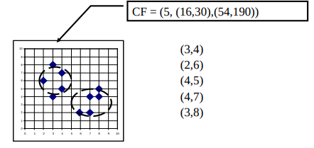


Hierarchical Clustering Me thods
Clustering Feature Vector in BIRCH
Clustering Feature (CF): CF = (N, LS, SS) \
  N: Number of data points
  LS: linear sum of N points:
  SS: square sum of N points:
Clustering feature:
  Summary of the statistics for a given sub-cluster: the 0-th, 1st, and 2nd moments of the sub-cluster from the statistical point of view
  Registers crucial measurements for computing cluster and utilizes storage efficiently
‹#›

Slide 22

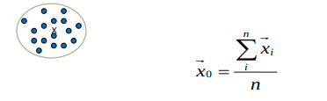
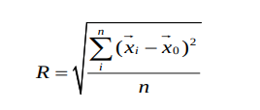
Hierarchical Clustering Me thods
Measures of Cluster: Centroid, Radius and Diameter
Centroid:
  the “middle” of a cluster
  n: number of points in a cluster
  is the i-th point in the cluster
Radius: R
  Average distance from member objects to the centroid
  The square root of average distance from any point of the cluster to its centroid
‹#›

Slide 23
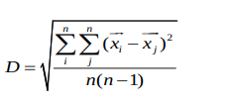
Hierarchical Clustering Me thods
Measures of Cluster: Centroid, Radius and Diameter
Diameter: D
  Average pairwise distance within a cluster
  The square root of average mean squared distance between all pairs of points in the cluster
‹#›

Slide 24
Hierarchical Clustering Me thods
The CF Tree Structure in BIRCH
Incremental insertion of new points (similar to B+-tree)
For each point in the input
  Find closest leaf entry
  Add point to leaf entry and update CF
  If entry diameter > max_diameter
    split leaf, and possibly parents
  A CF tree has two parameters
    Branching factor: Maximum number of children
    Maximum diameter of subclusters stored at the leaf nodes
‹#›

Slide 25
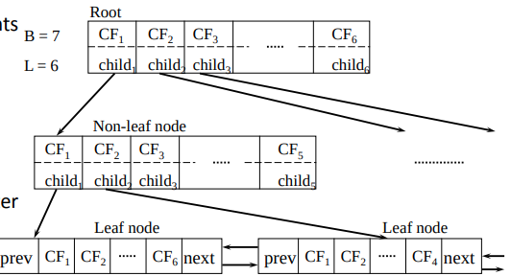
Hierarchical Clustering Me thods
The CF Tree Structure in BIRCH
A CF tree: A height-balanced tree that stores the clustering features (CFs)
The non-leaf nodes store sums of the CFs of their children
‹#›

Slide 26
Hierarchical Clustering Me thods
BIRCH: A Scalable and Flexible Clustering Method
An integration of agglomerative clustering with other (flexible) clustering methods
  Low-level micro-clustering
    Exploring CP-feature and BIRCH tree structure
    Preserving the inherent clustering structure of the data
  Higher-level macro-clustering
    Provide sufficient flexibility for integration with other clustering methods
‹#›

Slide 27
Hierarchical Clustering Me thods
BIRCH: A Scalable and Flexible Clustering Method
Impact to many other clustering methods and applications
Concerns
  Sensitive to insertion order of data points
  Due to the fixed size of leaf nodes, clusters may not be so natural
  Clusters tend to be spherical given the radius and diameter measures
‹#›

Slide 28
Hierarchical Clustering Me thods
BIRCH: Advantages and Applications
Applications:
  Network traffic analysis for intrusion detection.
  E-commerce customer segmentation.
  Biological sequence clustering.
  Sensor data analysis.
BIRCH's innovative micro-clustering strategy makes it a valuable tool for scalable and memory-efficient clustering tasks.
‹#›

Slide 29
Hierarchical Clustering Me thods
Case Study: Retail Store Clustering with Hierarchical Methods
Let's apply hierarchical clustering to a retail store dataset for location-based segmentation.
Objective:
  Group stores based on geographical sales patterns.
  Identify clusters with similar market behavior.
‹#›

Slide 30
Hierarchical Clustering Me thods
Case Study: Retail Store Clustering with Hierarchical Methods
Steps:
  Data Preparation: Convert store sales and location data into suitable format.
  Agglomerative Clustering: Apply agglomerative hierarchical clustering.
  Dendrogram Analysis: Analyze dendrogram to determine optimal cluster count.
  Cluster Interpretation: Interpret characteristics of formed clusters.
  Strategy Development: Design marketing strategies for each cluster.
  Hierarchical clustering helps unravel store behavior and guides targeted marketing efforts.
‹#›

Slide 31
Hierarchical Clustering Me thods
Hierarchical Clustering vs. Partitioning-Based Clustering
Hierarchical Clustering:
  Produces nested clusters in a tree-like structure.
  Offers exploration at different granularity levels.
  Dendrogram provides visual insights into cluster relationships.
  Suitable for diverse data types.
Partitioning-Based Clustering:
  Divides data into distinct, non-overlapping clusters.
  Requires specifying the number of clusters (K).
  Applicable for large datasets and efficient for K-Means.
  Offers flexibility in selecting different similarity measures.
‹#›

Slide 32
Hierarchical Clustering Me thods
Hierarchical Clustering vs. Partitioning-Based Clustering
Choosing between hierarchical and partitioning-based clustering depends on the data characteristics and analysis goals
‹#›

Slide 33
Hierarchical Clustering Me thods
Challenges and Considerations
Hierarchical clustering methods come with their own set of challenges and considerations.
Challenges:
  Dendrogram Interpretation: Determining the optimal number of clusters from a dendrogram.
  Computation Complexity: Agglomerative clustering can be resource-intensive for large datasets.
  Choice of Linkage: Selecting the appropriate linkage method based on data characteristics.
  Hierarchical Nature: Dendrograms may become complex and hard to interpret.
‹#›

Slide 34
Hierarchical Clustering Me thods
Challenges and Considerations
Considerations:
  Experiment with different linkage methods.
  Use silhouette scores or other metrics to evaluate cluster quality.
  Balance granularity and interpretability based on analysis goals.
‹#›

Slide 35
Hierarchical Clustering Me thods
Visualizing Hierarchical Clustering
Visualizing hierarchical clustering results enhances our understanding of formed clusters.
Dendrogram Visualization:
  Depicts merging/dividing process.
  Provides insights into cluster relationships.
  Helpful for selecting optimal cluster count.
‹#›

Slide 36
Hierarchical Clustering Me thods
Visualizing Hierarchical Clustering
Visualizing hierarchical clustering results enhances our understanding of formed clusters.
Cluster Visualization:
  Plot clusters in multidimensional space.
  Use dimensionality reduction techniques (e.g., PCA, t-SNE).
  Visualize cluster characteristics, separability, and patterns.
  Visualizations empower us to extract meaningful insights from complex hierarchical clustering outcomes.
‹#›

Slide 37
Hierarchical Clustering Me thods
Hierarchical Clustering in Data Exploration
Hierarchical clustering can be an effective tool for exploratory data analysis.
Data Exploration Benefits:
  Pattern Discovery: Identify inherent data patterns and relationships.
  Anomaly Detection: Detect outliers and unusual data points.
  Data Reduction: Group similar data points for summarization.
  Segmentation: Uncover distinct segments or subgroups.
By applying hierarchical clustering to data exploration, we unveil valuable insights that guide subsequent analyses and decision-making.
‹#›

Slide 38
Hierarchical Clustering Me thods
Recap and Key Takeaways
Agglomerative clustering merges data points into nested clusters.
Divisive clustering recursively divides data points into clusters.
Linkage methods (single, complete, average) influence clustering outcomes.
BIRCH utilizes micro-clustering for memory-efficient clustering.
Applications include retail store segmentation and gene expression analysis.
As you continue your journey through hierarchical clustering, remember the significance of dendrograms and the diverse applications of this method in various fields.
‹#›

Slide 39
Summary
Hierarchical Clustering
Hierarchical clustering organizes data in a tree-like structure.
Agglomerative starts with individual data points and merges them.
Divisive begins with all data in one cluster and splits iteratively.
Useful for exploring data hierarchy and relationships.
‹#›

